Slide 1


Slide 2
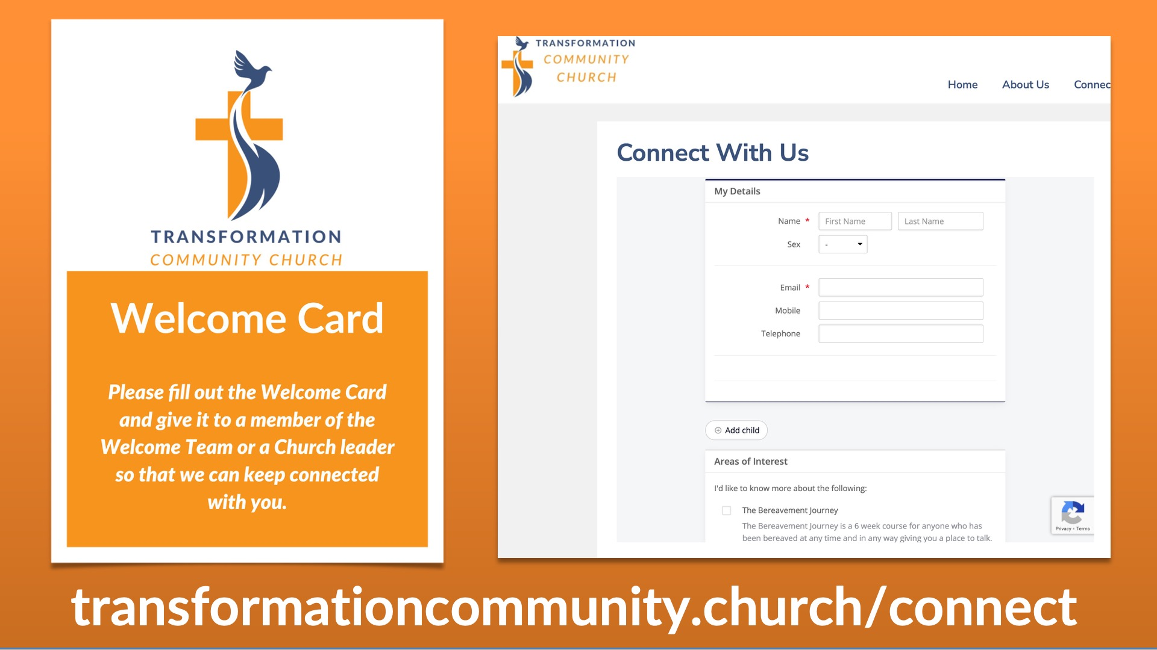

Slide 3

Pray for rest and
renewal for David and
Bev and deep
experience of God’s
presence and peace
Pray that we unite
as we use
our gifts to be
the church God has
called us to be

Slide 4
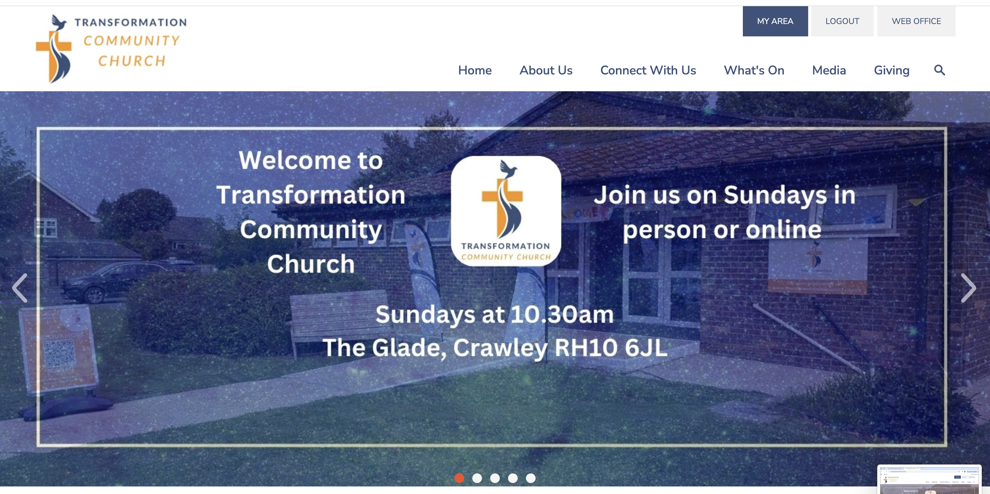

Slide 5


Slide 6


Slide 7


Slide 8
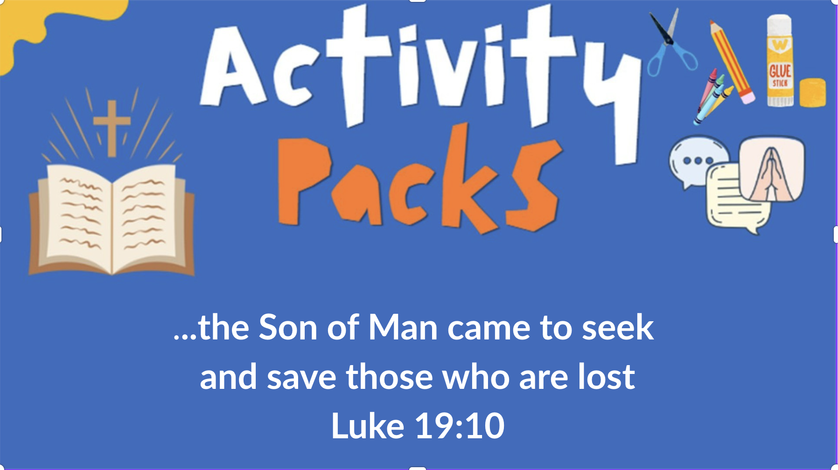
Moved with compassion, Jesus reached out and touched him. Mark 1:41

