Slide 1


Generosity –
The Beauty in Giving
Week Three- Generous Giving Comes From a Humble Heart

Slide 2

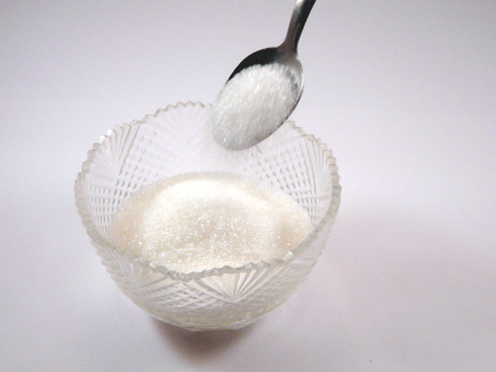


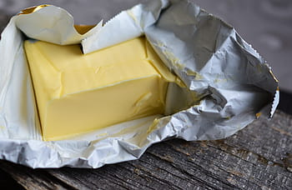

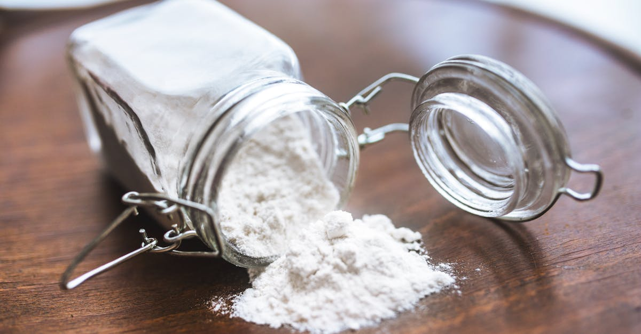

Slide 3


Slide 5

I give each of you this warning: Don’t think you are better than you really are. Be honest in your evaluation of yourselves, measuring yourselves by the faith God has given us
Generous Giving Comes From a Humble Heart

Slide 6
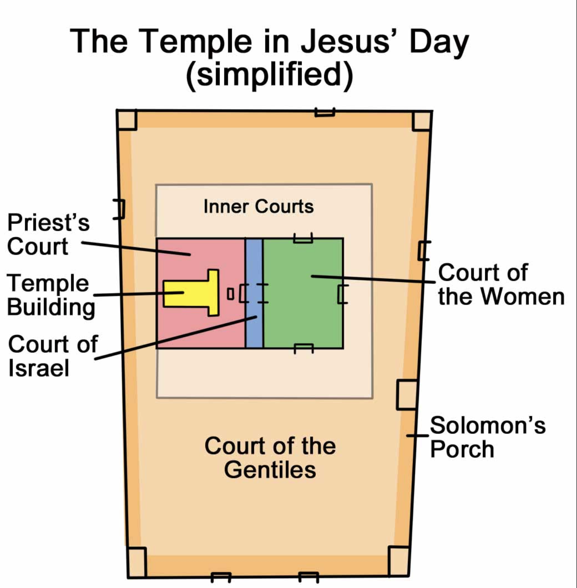

Slide 7
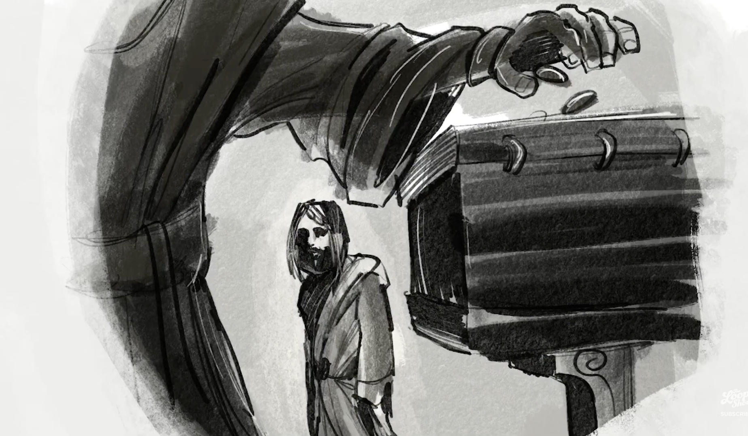
Jesus sat down near the collection box in the Temple and watched as the crowds dropped in their money.

Slide 8
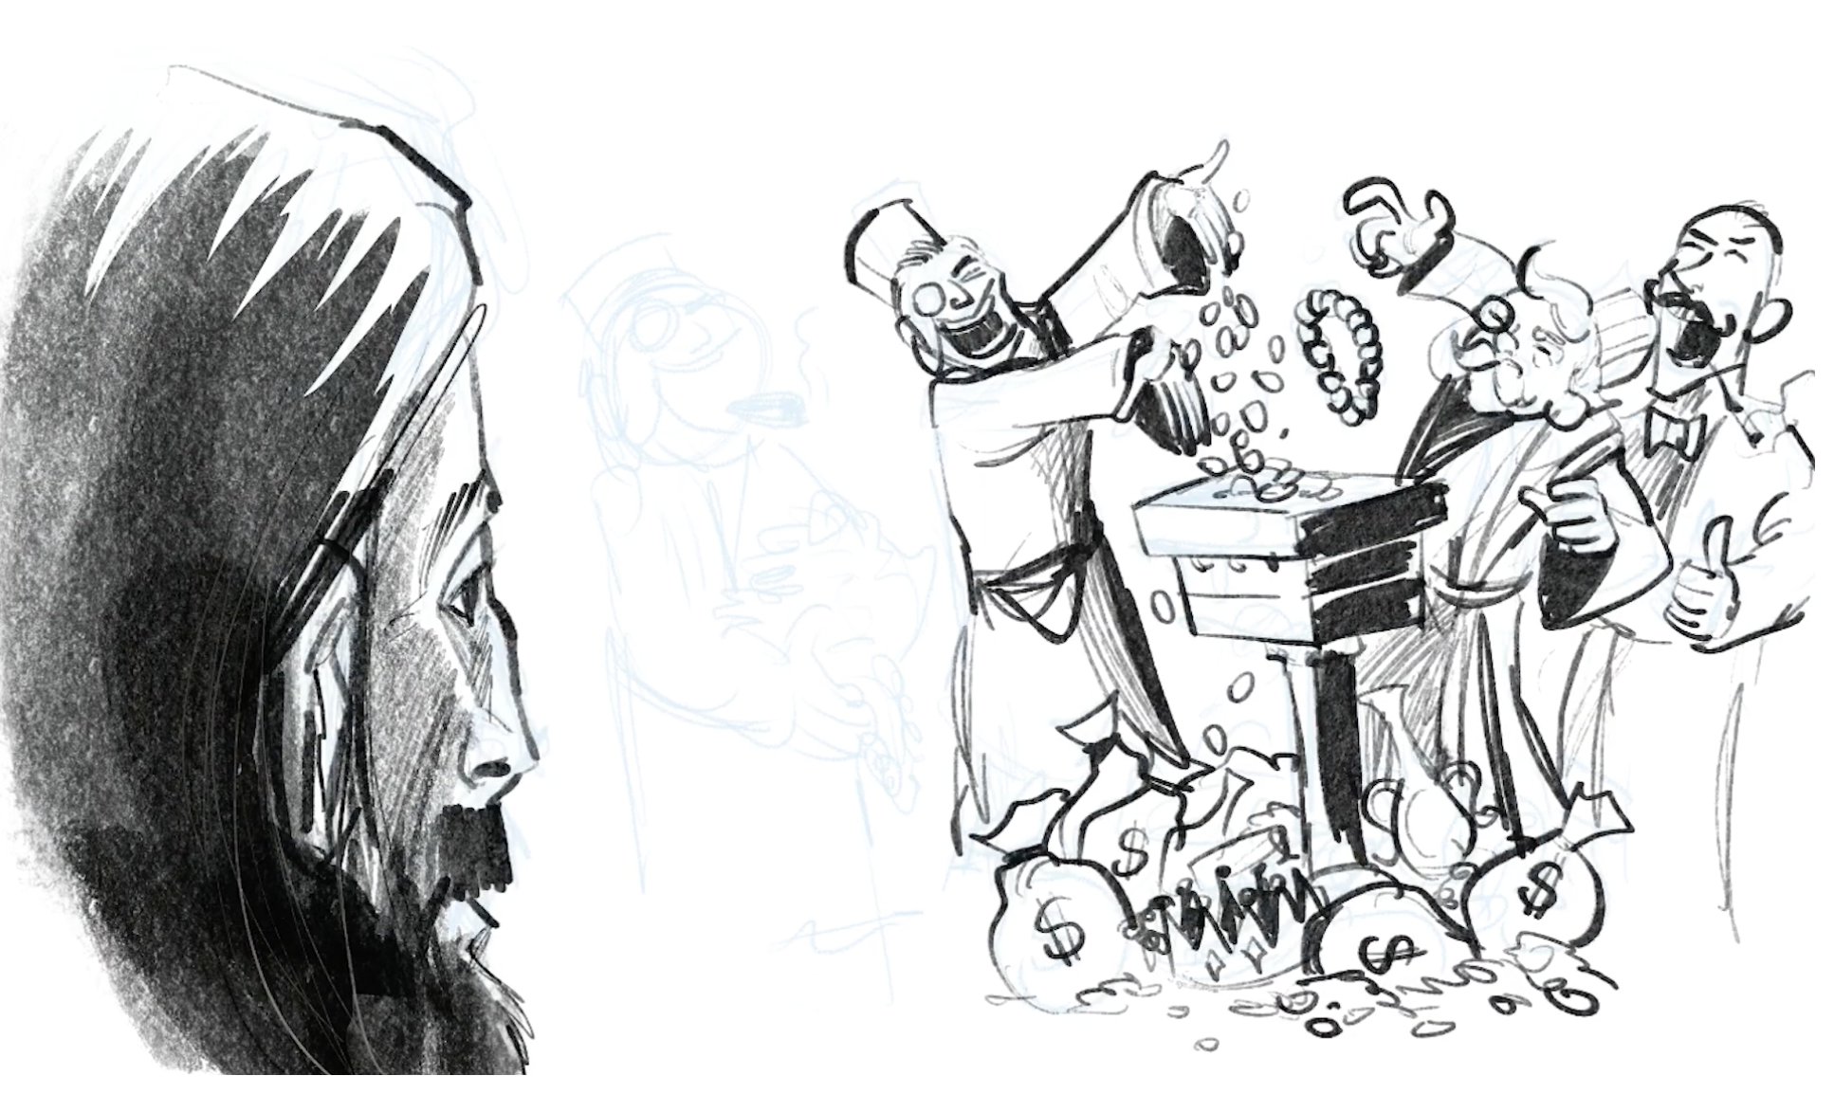
Many rich people put in large amounts

Slide 9
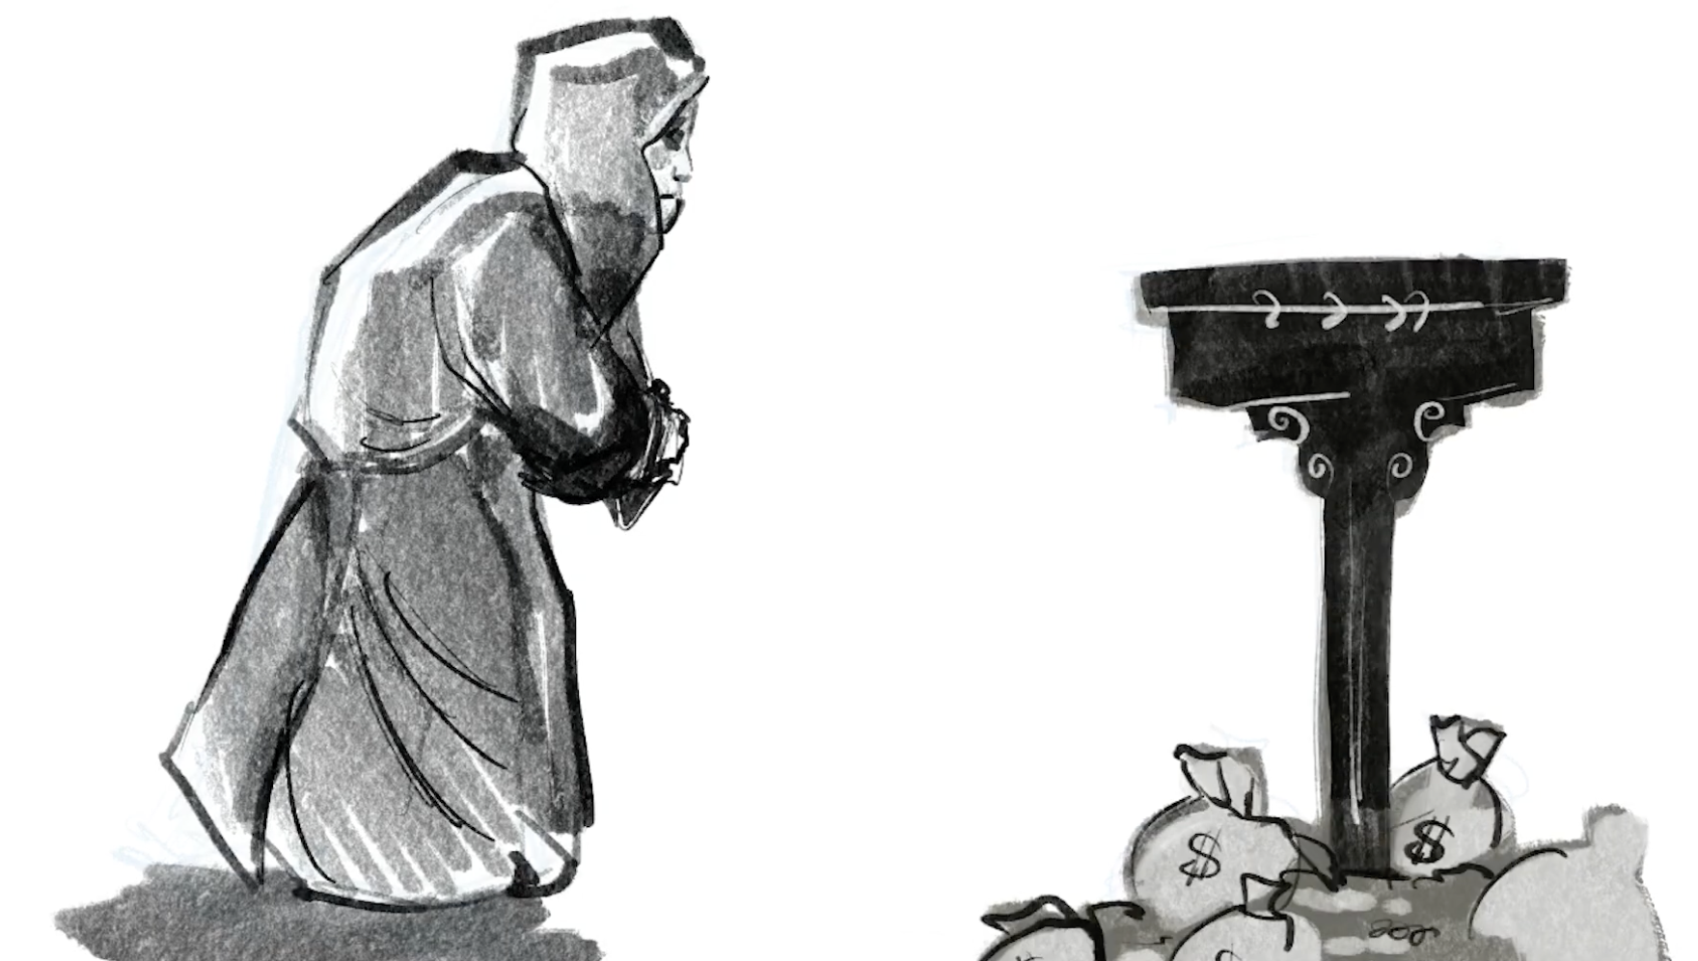
Then a poor widow came and dropped in two small coins.

Slide 10
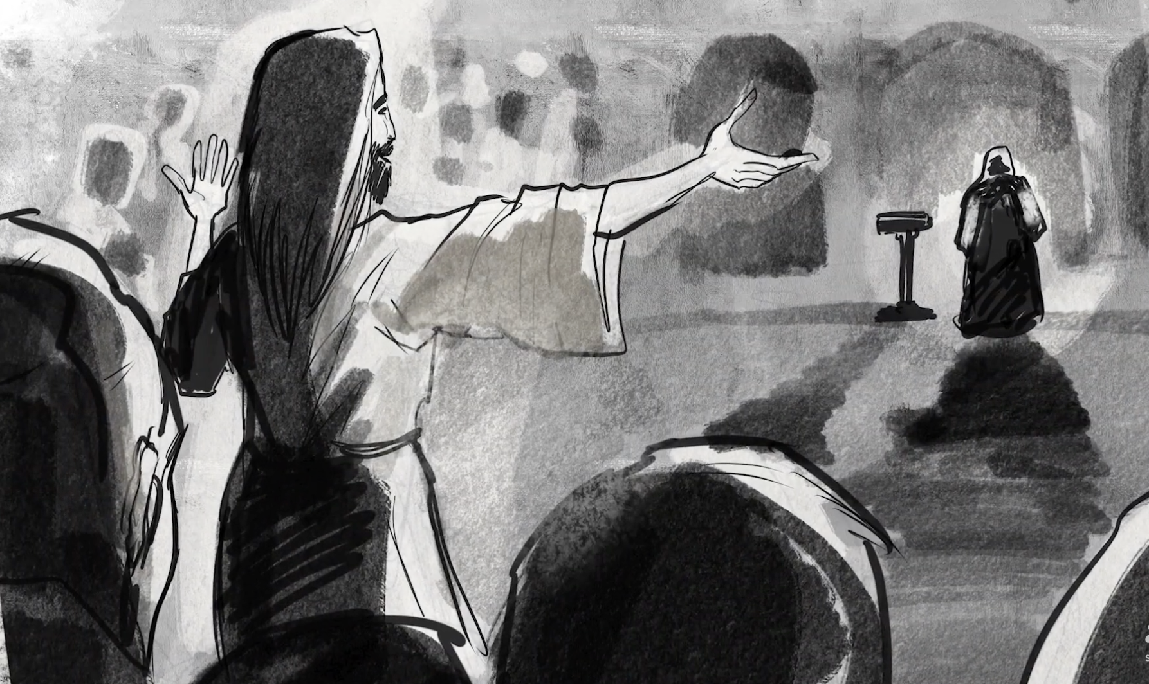
Jesus called his disciples to him and said, “I tell you the truth, this poor widow has given more than all the others who are making contributions. For they gave a tiny part of their surplus, but she, poor as she is, has given everything she had to live on.”

Slide 11
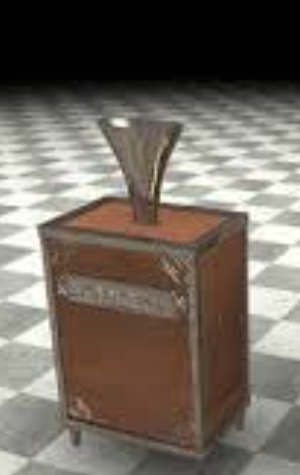
Giving from a humble heart involves cost.
Generous Giving Comes From a Humble Heart

Slide 12
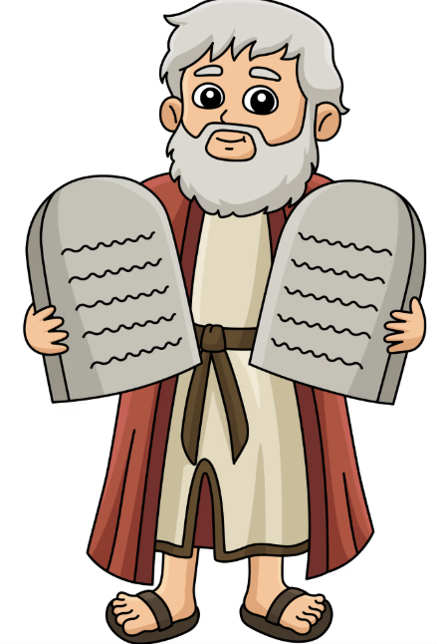
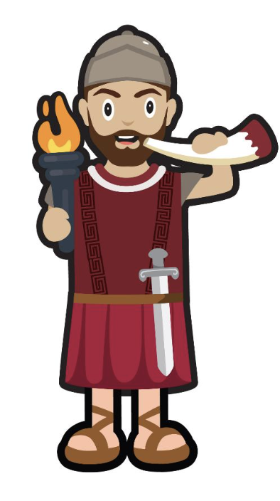
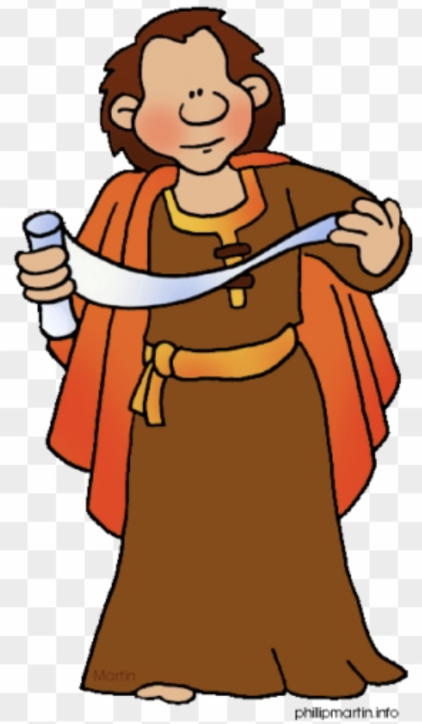

Generous Giving Comes From a Humble Heart

Slide 13
2. Giving from a humble heart
transforms lives.
Generous Giving Comes From a Humble Heart

Slide 14
“Beware of these teachers of religious law! For they like to parade around in flowing robes and receive respectful greetings as they walk in the marketplaces. And how they love the seats of honor in the synagogues and the head table at banquets. Yet they shamelessly cheat widows out of their property and then pretend to be pious by making long prayers in public.
Matthew 12:38-40
Generous Giving Comes From a Humble Heart

Slide 15
How will God use TCC to
transform Lives?
Us being healthy
Generous Giving Comes From a Humble Heart

Slide 16


Immerse yourself in God's grace and connect with it in your heart, not just your head.
https://www.transformationcommunity.church/Groups/451187/Grace_Course.asp
x

Slide 17
How will God use TCC to
transform Lives?
Us being healthy
Us opening our doors
Generous Giving Comes From a Humble Heart

Slide 18
How will God use TCC to
transform Lives?
Us being healthy
Us opening our doors
Us working in unity
Generous Giving Comes From a Humble Heart

Slide 19
Generous Giving Comes From a Humble Heart

Slide 20
CONCLUSION/RESPONSE
“…she, poor as she is, has given everything”
What is God speaking to you about
through this passage?
What risk is He asking you to take personally,financially, relationally ?
Generous Giving Comes From a Humble Heart

